Slide 1
Routine Practices that Improve Grant-Writing
Regularly read the top journals in your field
“Like” these journals on Facebook to keep up with the academic conversations going on
Read yearly reviews of research trends
i.e. American Anthropologist’s “The Year 2012 in Cultural Anthropology
Follow funding agencies on Twitter or Facebook
They often post advice on applying for their grants
Treat all writing that you do for your classes as opportunities for refining research questions & getting feedback
Read other successful proposals and analyze their structure
How do they set up a puzzle? How do they make it interesting? How do they build the narrative around their research questions

Slide 2
Gather & Organize Information
Look for funding sources for all stages of graduate school
i.e. pre-candidacy, fieldwork, dissertation writing
Identify all possible funding agencies and make a calendar with deadlines
Note if you need transcripts, language exams, etc.
Note earlier campus deadlines for Fulbright deadlines
Some grants may have two grant-awarding deadlines (NSF)
Plan for IRB deadlines
Share this calendar with your committee members and set up deadlines with them for submitting drafts.

Slide 3
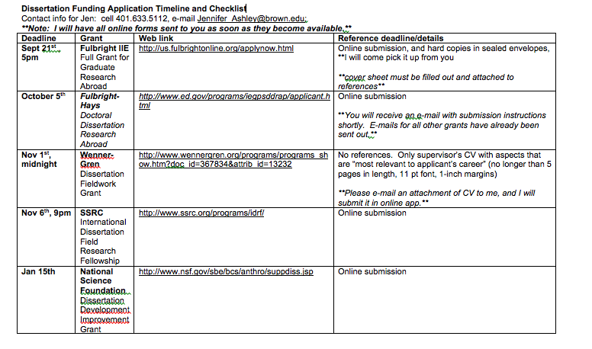

Slide 4
Good Practices for Working with Advisors/Committees
Recommendation letters
Ask for letters one month in advance when possible
Ask if recommenders would like reminder emails
Offer to provide drafts when you request letters
Sending drafts
Use descriptive email subject headings
e.g. Ashley NSF Draft 11.13
Name the document with your last name, the name of the grant, and the date
Put the date of your draft in the header of the document
Acknowledge receipt of feedback

Slide 5
Fulbright-Hays
KEY:
Address the country-specific question:
Why is studying this question in this place significant?
You must hit every point
They score you numerically and you must explicitly address everything that they ask for
Narrative
Statement of the Research Problem, Theoretical Framework & Significance, Methodology & Research Plan, Preliminary Research, Dissemination of Findings

Slide 6
NSF Dissertation Improvement Grants
Key:
3x3 strategy: 3 questions, 3 literatures, 3 primary methods components – ALL explicitly connected
Methodology must be carefully described and should clearly respond to research objectives
Your reader should not only be able to imagine what you will be doing every day, but why you will be doing it (what will you be listening for?
Who are you interviewing and why? What are you looking to learn? How would you know you have learned it? What will you be listening for?
Narrative Elements
Statement of the Research Problem, Review of the Literature, Research Objectives, Preliminary Studies, Research Design, Data Management & Analysis, Significance (Intellectual Merit &Broader Impact)

